Slide 1

Artists dealing with MNCs
What to know when commercializing artworks
Art & Cultural Heritage Law Committee • International Law Section • American Bar Association
Oct. 22, 2026 | 11:00 am – 12:00 noon ET | Hybrid

Slide 2

WELCOME
The ABA Art & Cultural Heritage Law Committee
Part of the ABA Section of International Law.
  Unites legal professionals, legal scholars, law students, and museum and cultural institution professionals.
  Focuses on the legal aspects of art and cultural heritage both nationally and internationally.
  Programming includes telecoffees, panels, newsletters, special projects, and working groups.
Open to all ABA members with an interest in art, cultural heritage, and the law.

Slide 3
ABA ACH TELECOFFEE SERIES
  Content: Legal practitioner-focused conversations on timely and cutting-edge topics at the intersection of art, cultural heritage, and law. Professional sharing of insights and experiences from speakers.
  Purposes: Designed to spark dialogues between speakers, members, and attendees. Prepare your questions and share constructive perspectives.
  Audience: Free and open to ABA members. Selected Open Access activities to encourage community participation for educational purposes.
  When: Recurs every 4th Thursday of the month, except August.

Slide 4
HOUSE-KEEPING RULES
  Microphone: Please mute during the speaker’s presentation.
  Questions: Please key in the chat box.
  Recording: If attendee does not wish his/her image and voice to be recorded, please be reminded to turn off the camera and microphone.
  Remark: Speakers present their personal views and do not reflect the views of their affiliations, ABA, or constitute any legal advice.

Slide 5
Meet Our Speakers

Slide 6
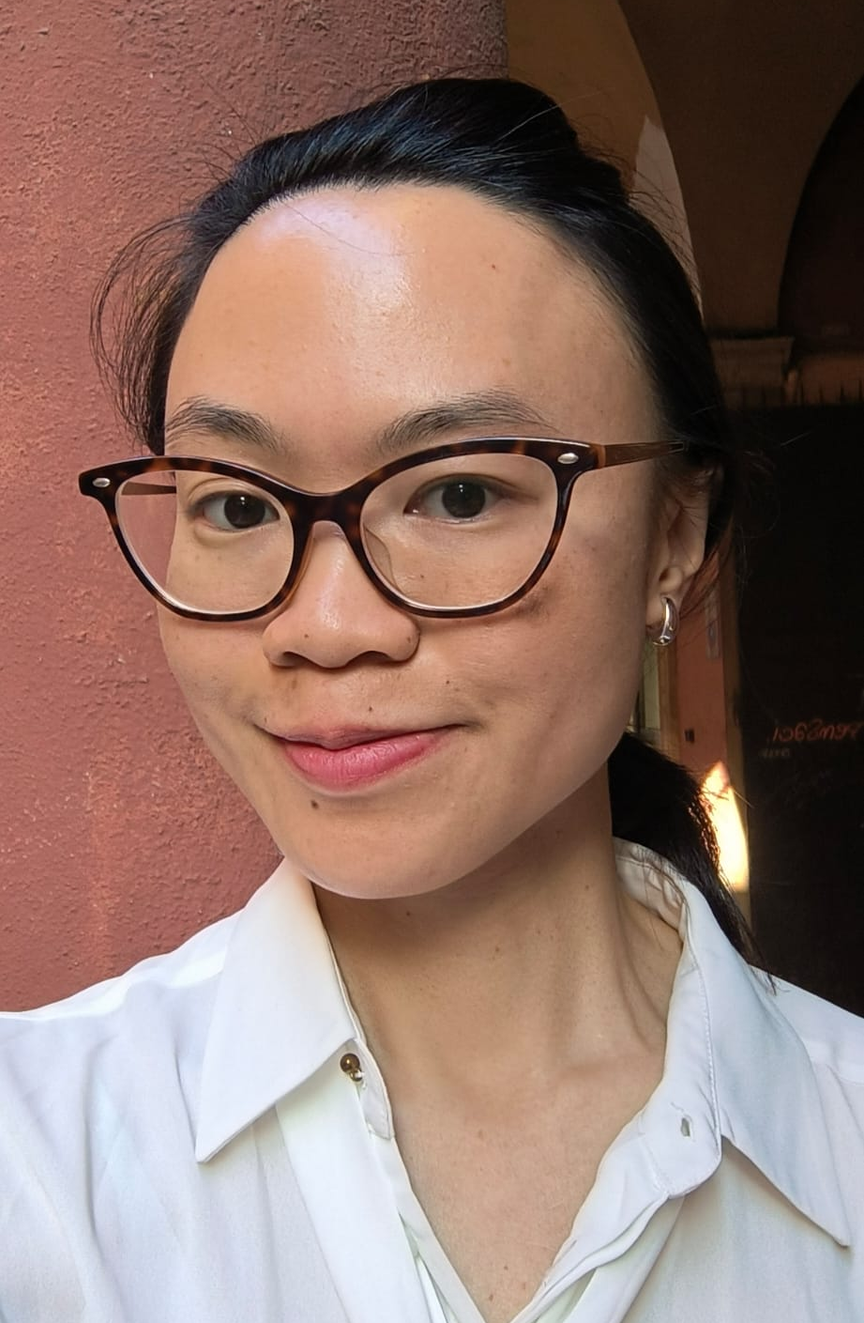
MODERATOR
Maria Goretti Tai
Co-Chair, ABA Art and Cultural Heritage Law Committee
PhD Researcher, Alma Mater Studiorum - Università di Bologna https://www.linkedin.com/in/mariagorettitai/
  Attorney, New York Bar
  Copyright litigator
  LLM, UCLA
  MA in Cultural Experience Design & Management, Domus Academy, IT
  Research areas
    Digital cultural heritage law
    Comparative law: art law, cultural heritage law, IP and technology law
    Conflicts between public law and private law

Slide 7
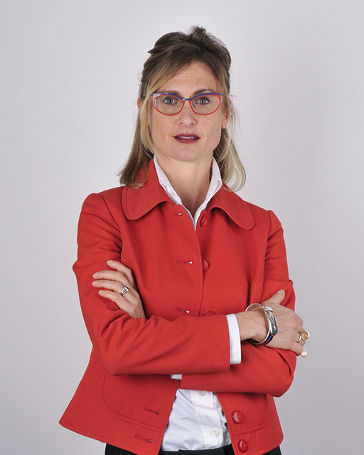
SPEAKER
Partner, FPBLegal (Milan-Bologna-Trieste, Italy)
https://www.fpblegal.com/en/professionals/lavinia-savini/
Lavinia Savini
  Expert in IP & art market law
  Member: International Commission of Bologna Bar Association; Intellectual Property Commission of the Council of European Bar Associations; APRAM Paris, Art et Droit Association in Paris, Art Commission of UIA and Paris Bar Association.
  Represents UIA (Union Internationale des Avocats) at WIPO
  Arbitrator & Member of the Scientific Committee Venice Chamber of Arbitration
  Law degree ‘maxima cum laude’ from Alma Mater Studiorum - University of Bologna, postgraduate scholarships in Protection and Preservation of Cultural Heritage from the University “La Normale” of Pisa, and Université Paris1 Pantheon-Sorbonne
  Publications, amongst others: co-author “The Cambridge Handbook on Intellectual Property and Gender Bias in the Arts” Cambridge University Press 2026; "Regulating Artificial Intelligence in the Light of European Regulation: France and Italy in comparison”, Il Diritto d'Autore, Giuffrè, 2025; The Protection of Interior Layout" in "Design and Digital Innovation", Edizioni Scientifiche Italiane, 2021; Copyright Protection for Fashion Creations" in "Fashion Law", LexisNexis, 2020.

Slide 8
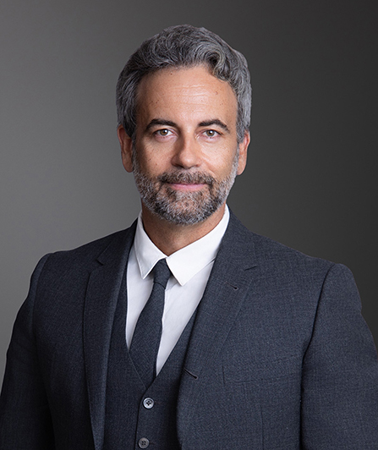
SPEAKER
Scott Alan Burroughs, Esq.
Managing Partner, Doniger-Burroughs’ New York office (USA)
National Society of Entertainment & Arts Lawyers, Regional Director for East Coast
https://donigerlawfirm.com/attorneys/scott-alan-burroughs/
  >20 years battling for artists' rights
  2015-2019 California Rising Star, Los Angeles Magazine and Super Lawyers
  2021-2026 New York Super Lawyer
  2024 Top Music Lawyer, Billboard Magazine
  2nd, 9th, 11th cir., US S. Ct.: Appeals on cutting-edge issues in copyright law
  Publishes on art, copyright, and entertainment law issues
  Recent publication: misuse of "prior art" in copyright litigation
  Clients: writers, designers, photographers, street artists, tattoo artists, graphic artists, producers, and performers

Slide 9
Today’s Discussion

Slide 10
TODAY’S DISCUSSION
Artists vs MNCs: What to know when commercializing artworks
  Copyright registration
  Contractual negotiation
  Copyright litigation strategies
  Calculation of damages
  ADR

Slide 11
ART COMMERCIALIZATION roadmap
Contract Negotiation
damages
3
Pecuniary,
non-pecuniary
8
Clauses,
Forum
Contract Negotiation
ADR
2
6
Digital artworks,
Online uses
Obligation ?
1
Copyright registration
7
Proof of authorship
4
Litigation strategies
awards
Contract Negotiation
Tackling opponent’s delaying tactics
Atty’s fees
ADR
5

Slide 12
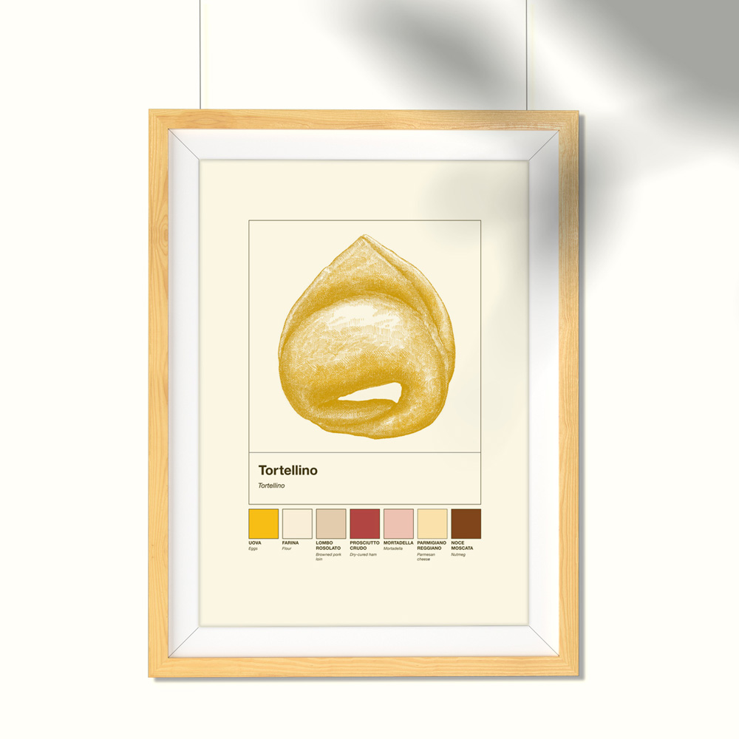
Cati Cristina vs IKEA Italia Retail srl (Tribunal of Bologna, n.R.G. 6999/2022, 2026)
  ‘Tortellino con Ingredienti’
https://www.modoro.it/prodotto/stampa-a4-ingredienti-tortellino/

Slide 13
Unicolors, Inc. v. H&M Hennes & Mauritz, L. P., 595 U.S. (2022)
  xxx

Slide 14
OVER TO YOU
The floor is open.
Please submit questions using the chat function.

Slide 15
RESOURCES
Lavinia Savini, FPB Legal (Bologna, Italy)
https://www.fpblegal.com/en/professionals/lavinia-savini/
Scott Alan Burroughs, Esq., Doniger/ Burroughs (New York, USA)
https://donigerlawfirm.com/attorneys/scott-alan-burroughs/
Unicolors, Inc. vs H&M Hennes & Mauritz, L. P., 595 U.S. (2022)
https://supreme.justia.com/cases/federal/us/595/20-915/
ABA ACH Committee on LinkedIn
https://www.linkedin.com/company/art-and-cultural-heritage-law-committee-aba-international-law-section/about/?viewAsMember=true

Slide 16
Thank You
Art & Cultural Heritage Law Committee • International Law Section • American Bar Association

